Slide 1


Algorithms: The Building Blocks of Programming
Algorithms are the backbone of computer programs. They provide a step-by-step plan for solving problems.
by Istiak Rahman

Slide 2

Understanding Algorithms
An algorithm is a step-by-step guide for solving a problem.
1
Sequence
Steps are followed in order.
2
Selection
Decisions are made based on what's true.
3
Iteration
Steps are repeated until a condition is met.

Slide 3
Pseudocode: A Simplified Representation
Pseudocode is a way to express algorithms using plain language.
Readability
Flexibility
Translation
Easy to understand, even for non-programmers.
Not bound by the strict rules of programming languages.
Can be easily converted into actual code.

Slide 4

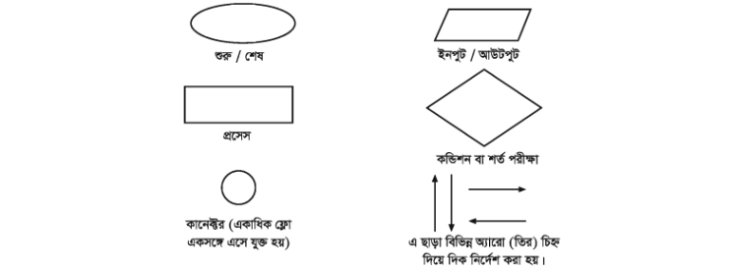
Flowcharts: Visualizing Algorithms
Flowcharts use symbols to represent the steps and decisions in an algorithm.
Symbol
Description
Oval
Start/End of the process.
Parallelogram
Input/Output operation.
Rectangle
Process or operation.
Diamond
Decision point (if/else).

Slide 5




Benefits of Algorithms
Algorithms offer several advantages for software development and problem-solving.
Efficiency
Algorithms can optimize processes and reduce time.
Accuracy
Algorithms ensure consistent and reliable results.
Automation
Algorithms automate tasks, freeing up human effort.

Slide 6





Algorithm Examples in Everyday Life
Algorithms power many technologies we use daily.
GPS Navigation
Algorithms determine the shortest and fastest route.
Social Media Recommendations
Algorithms suggest content based on your interests.
Search Engines
Algorithms rank websites based on relevance.
Online Shopping
Algorithms suggest products based on your browsing history.

Slide 7

Thank You!
Presented by: Istiak Rahman
Email: istiak.rahman1020@gmail.com
Thank you for your attention! I appreciate your time and interest.
Keep Learning, Keep Growing

